Slide 1
The A-Z of Geo Skills
Year 8

Slide 2
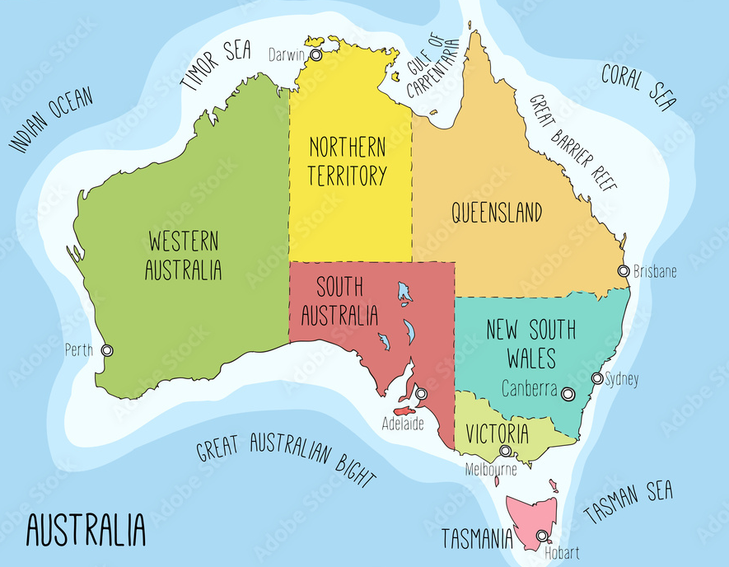
A
Aussie Place Geo
• Hopefully you learned your States (6), Territories (2) and Capital Cities in Primary School!
• If not, here is a quick refresher.
The A-Z of Geo Skills
ACT

Slide 3
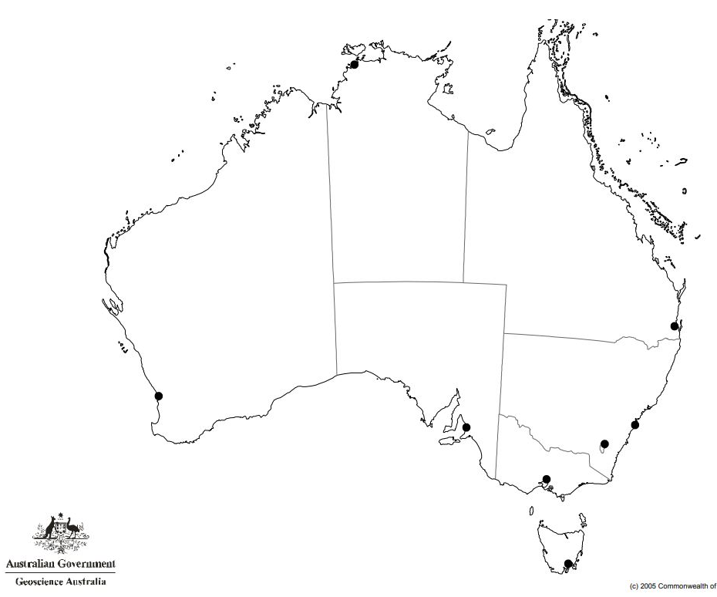
A
Aussie Place Geo
EXAM STYLE Qs
What capital city is “A”?
What capital city is “G”
What capital city is “H”?
What State/Territory is “2”?
What State/Territory is “3”?
What State/Territory is “6”?
B
2
4
1
The A-Z of Geo Skills
3
D
A
5
C
F
E
ACT
7
G
6
8
H

Slide 4
A
Aussie Place Geo
EXAM STYLE Qs
What capital city is “A”?
Perth
What capital city is “G” Melbourne
What capital city is “H”?
Hobart
What State/Territory is “2”? NT
What State/Territory is “3”? SA
What State/Territory is “6”?
ACT
B
2
4
1
The A-Z of Geo Skills
3
D
A
5
C
F
E
ACT
7
G
6
8
H

Slide 5
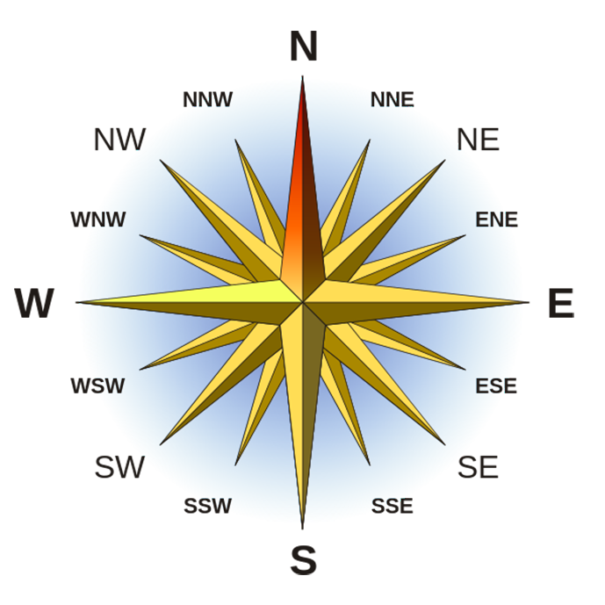
D
Direction
• Direction is important because it shows where one place is in relation to another
• North, South, East & West are known as the cardinal points of a compass while the others are known as intermediate points
• TIPS: Never Eat Soggy WeetBix will help you remember the 4 cardinal points; you need to learn NE, SE, SW & NW; if you forget the others then always go to the cardinal point first ~ eg. the direction between N & NW is NNW
The A-Z of Geo Skills

Slide 6
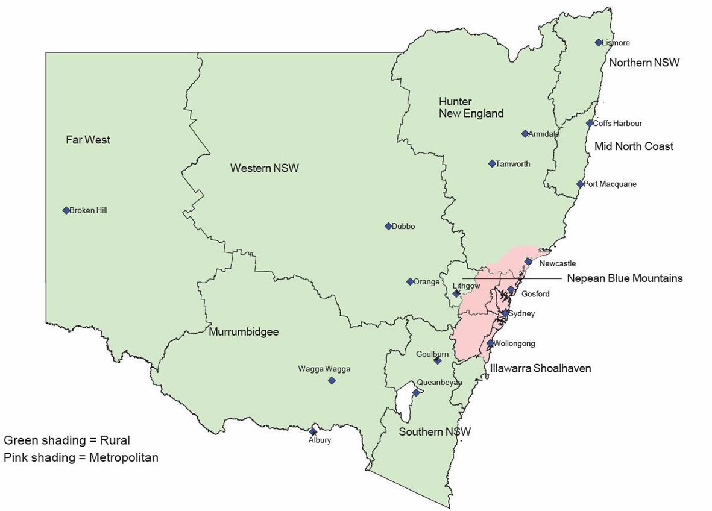
D
Direction
EXAM STYLE Qs
Q1) What direction is Armidale from Newcastle?
Q2) What direction is Dubbo from Tamworth?
Q3) What direction is Broken Hill from Albury?
Q4) What direction is Newcastle from Lismore?
Q5) Which region borders Northern NSW to
the south?
Q6) In what direction is Port Macquarie from
Sydney? A) N
B) NE
C) NNE
D) ENE
The A-Z of Geo Skills

Slide 7
D
Direction
ANSWERS:
Q1) What direction is Armidale from Newcastle?
N
Q2) What direction is Dubbo from Tamworth?
SW
Q3) What direction is Broken Hill from Albury?
NW
Q4) What direction is Newcastle from Lismore?
SSW
Q5) Which region borders Northern NSW to
the south?
Mid North Coast
Q6) In what direction is Port Macquarie from
Sydney? A) N
B) NE
C) NNE
D) ENE
The A-Z of Geo Skills

Slide 8
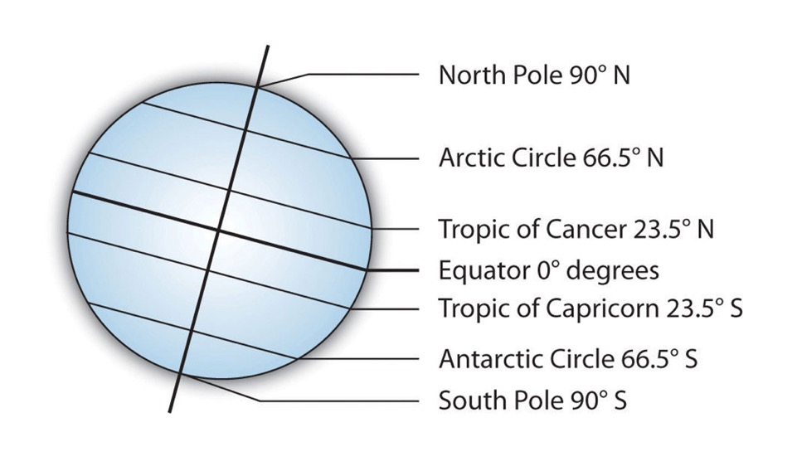
L
Latitude
• Lines of latitude are imaginary horizontal lines that run from east to west
• They are also called parallels of latitude as they are parallel to the Equator (which is 40,075 km in length)
• The maximum latitude is 90⁰
• The latitude of a place is crucial in determining climate
• Equatorial places are warmer because they are closer to the sun (the poles are furthest)
• There are 5 major lines of latitude (shown adjacent)
• TIP: LAT is FLAT!
The A-Z of Geo Skills
Exam Style Questions:
Q1) What is the maximum latitude?
Q2) Which Tropic runs through Australia?
Q3) True or False, all lines of latitude are the same size?

Slide 9
L
Latitude
• Lines of latitude are imaginary horizontal lines that run from east to west
• They are also called parallels of latitude as they are parallel to the Equator (which is 40,075 km in length)
• The maximum latitude is 90⁰
• The latitude of a place is crucial in determining climate
• Equatorial places are warmer because they are closer to the sun (the poles are furthest)
• There are 5 major lines of latitude (shown adjacent)
• TIP: LAT is FLAT!
The A-Z of Geo Skills
ANSWERS:
Q1) What is the maximum latitude?
90⁰
Q2) Which Tropic runs through Australia?
Tropic of Capricorn
Q3) True or False, all lines of latitude are the same size?
False, they get smaller as you approach the poles

Slide 10
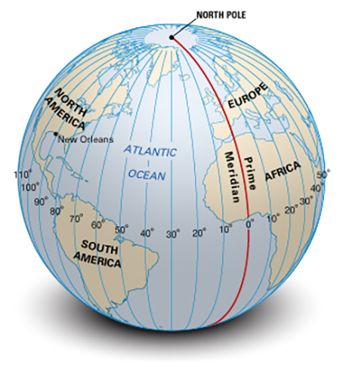
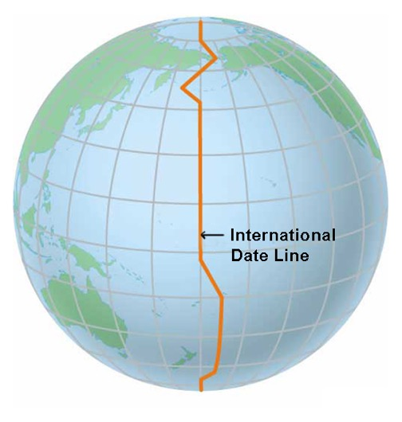
L
Longitude
• Lines of longitude are imaginary vertical lines that run from north to south
• They are also called meridians
• They are measured east or west of the Prime Meridian aka the Greenwich Meridian after the London suburb through which it runs
• They are farthest apart at the Equator and meet at the poles
• The max longitude is 180⁰
• There are 2 major lines of longitude (shown adjacent)
• TIP: LONG IS LONG!
The A-Z of Geo Skills
Exam Style Questions:
Q1) What is the maximum longitude?
Q2) Would New Orleans and New York be E or W of Greenwich?
Q3) Why is the International Date Line crooked in parts?

Slide 11
L
Longitude
• Lines of longitude are imaginary vertical lines that run from north to south
• They are also called meridians
• They are measured east or west of the Prime Meridian aka the Greenwich Meridian after the London suburb through which it runs
• They are farthest apart at the Equator and meet at the poles
• The max longitude is 180⁰
• There are 2 major lines of longitude (shown adjacent)
• TIP: LONG IS LONG!
The A-Z of Geo Skills
ANSWERS:
Q1) What is the maximum longitude?
180⁰
Q2) Would New Orleans and New York be E or W of Greenwich?
West
Q3) Why is the International Date Line crooked in parts?
So that countries don’t have towns/cities where there are separate days occurring a few metres apart!

Slide 12
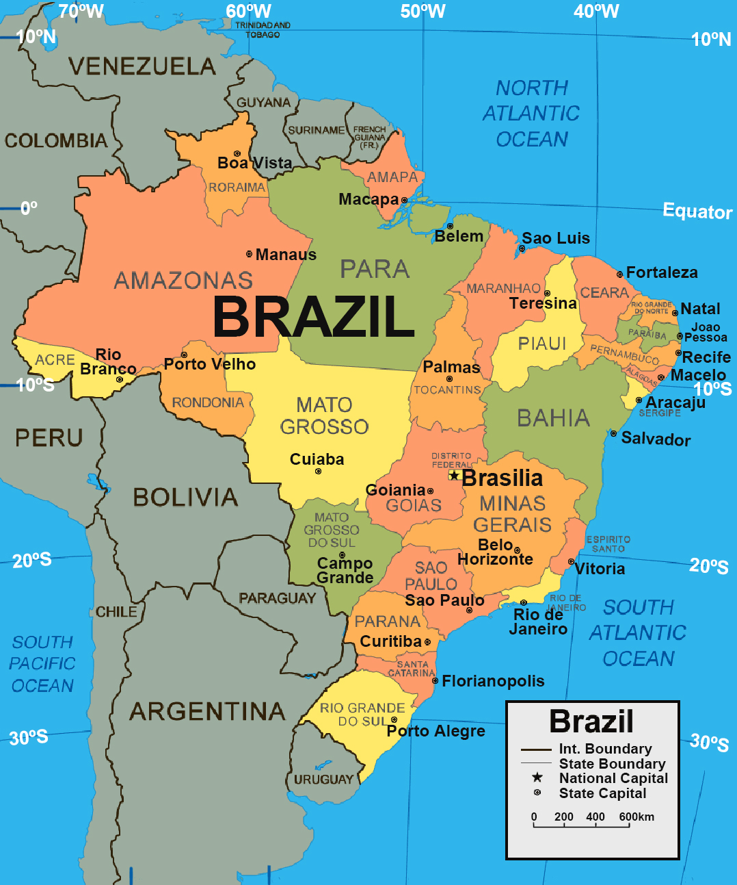
L
Latitude & Longitude
• Latitude is ALWAYS written before longitude
• In the map adjacent, Rio de Janeiro’s location is 23ºS, 43ºW…. while
Porto Alegra’s location is 30ºS, 51ºW.
•. TIP: LAT is before LONG in the dictionary … and so it is when you give lats and longs
The A-Z of Geo Skills

Slide 13
L
Latitude & Longitude
Q1:
What is the location of Sao Luis?
(using lat + long)
A. 2ºS, 44ºE
B. 8ºS, 44ºW
C. 2ºS, 44ºW
D. 2ºS, 54ºW
The A-Z of Geo Skills
Q2:
What is the location of Boa Vista?
(using lat + long)
A. 2.5ºS, 60.5ºW
B. 2.5ºN, 60.5ºW
C. 2.5ºS, 59ºW
D. 2.5ºN, 59ºE

Slide 14
L
Latitude & Longitude
Q1:
What is the location of Sao Luis?
(using lat + long)
A. 2ºS, 44ºE
B. 8ºS, 44ºW
C. 2ºS, 44ºW
D. 2ºS, 54ºW
Answer:
C: 2ºS, 44ºW
The A-Z of Geo Skills
Q2:
What is the location of Boa Vista?
(using lat + long)
A. 2.5ºS, 60.5ºW
B. 2.5ºN, 60.5ºW
C. 2.5ºS, 59ºW
D. 2.5ºN, 59ºE
Answer:
B: 2.5ºN, 60.5ºW. It’s north of the equator!

Slide 15
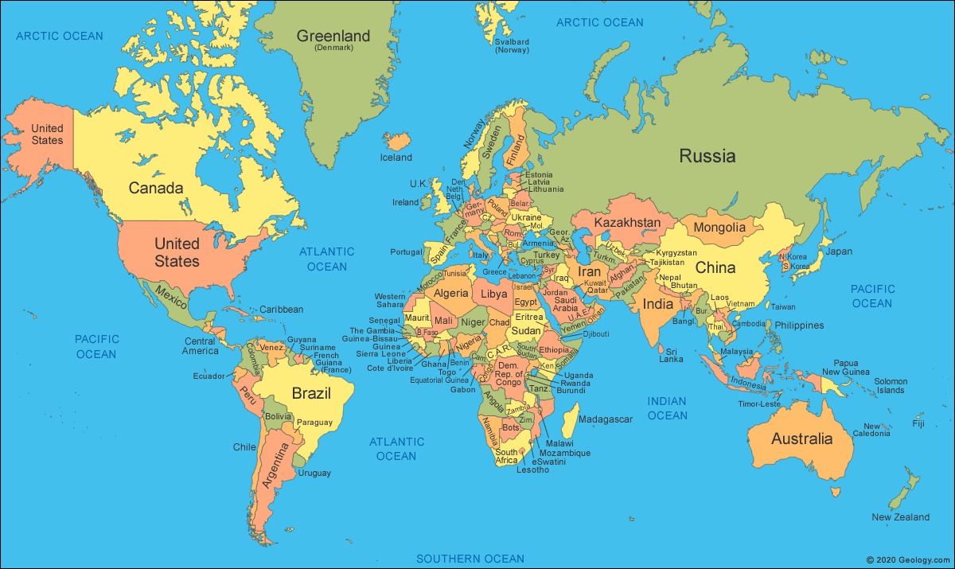
M
Map quadrants
As the name suggests,
there are 4 map
quadrants:
• NW
• SW
• NE
• SE
NW
NE
The A-Z of Geo Skills
SW
SE

Slide 16
M
Map quadrants
The A-Z of Geo Skills
EXAM STYLE Q
In what map quadrant is Australia?

Slide 17
M
Map quadrants
The A-Z of Geo Skills
EXAM STYLE Q
In what map quadrant is Australia? Answer: South East (SE)

Slide 18
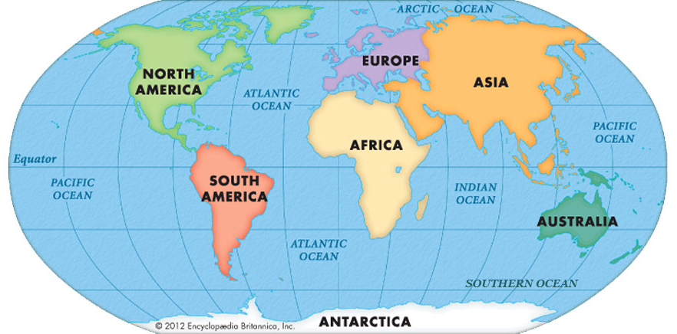
W
World Map
Learn your continents; oceans and major mountain ranges
Rockies Mtns
Alps Mtns
Himalayan Mtns
The A-Z of Geo Skills
Andes Mtns

Slide 19
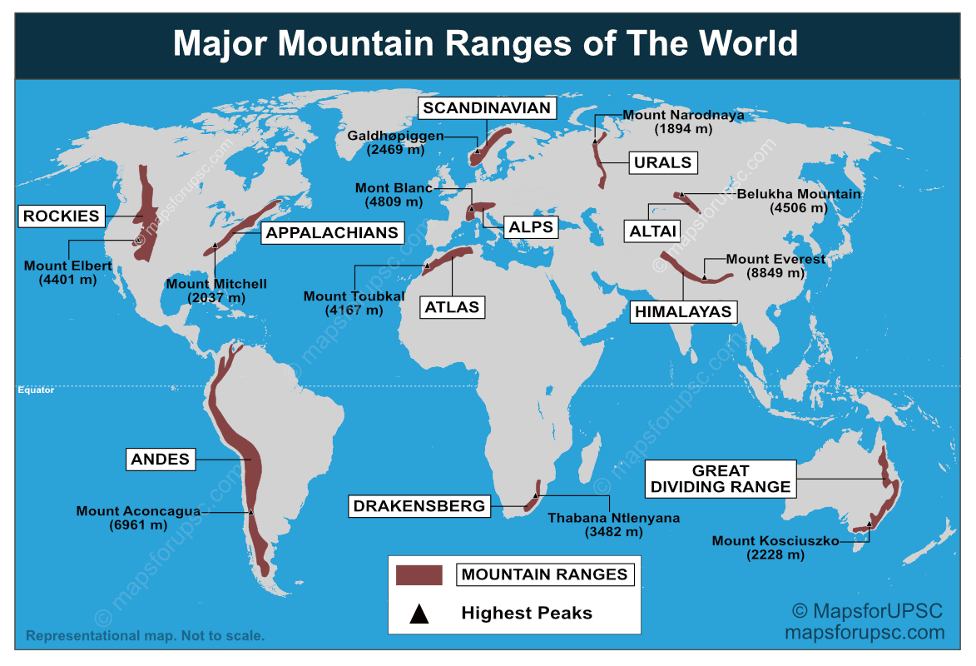
W
Some others
World Map
The A-Z of Geo Skills

Slide 20
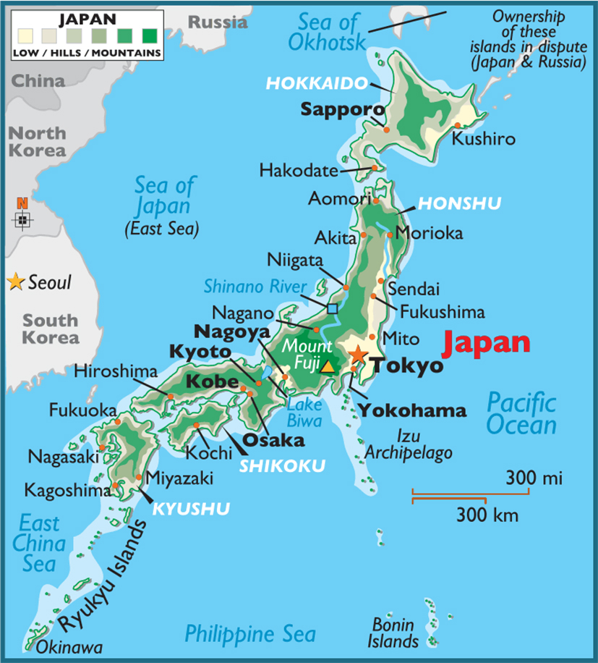
X
Exam Practice
• Practice your Geo skills with this map of Japan
Exam Style Questions:
Q1) What direction is Mount Fuji from Tokyo?
Q2) True or False, Kyoto lies in a mountainous region?
Q3) How many km from Tokyo to Sapporo?
Q4) What is the body of water W of the Bonin Islands?
Q5) True or False, there are 1.6 miles to every 1 km?
Q6) What direction is Hiroshima from Miyazaki?
Q7) Describe the terrain in Kushiro?
The A-Z of Geo Skills

Slide 21
X
Exam Practice
• Practice your Geo skills with this map of Japan
ANSWERS:
Q1) What direction is Mount Fuji from Tokyo?
SW or WSW
Q2) True or False, Kyoto lies in a mountainous region?
True
Q3) How many km from Tokyo to Sapporo?
900 km (approx)
Q4) What is the body of water W of the Bonin Islands?
Philippine Sea
Q5) True or False, there are 1.6 miles to every 1 km?
False (it is the other way around)
Q6) What direction is Hiroshima from Miyazaki?
NNE
Q7) Describe the terrain in Kushiro?
low lying, flat, coastal terrain (low is the key word)
The A-Z of Geo Skills

